Slide 1
Predictive Quality Analytics PoC
Sutherland
Dec 2023

Slide 2
Objectives of the POC:
What is Predictive Q
Performance Benchmarking
Cost-Benefit Analysis
Performance Monitoring
Feedback Loop Creation
“
”

Slide 3
Advantages of PQ

Slide 4
Predictive Quality Analytics

Slide 5
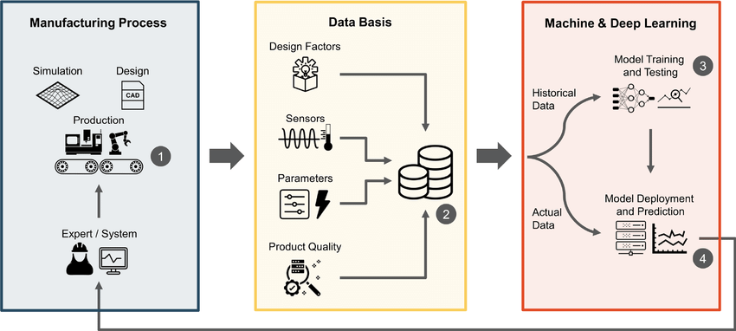

Slide 6






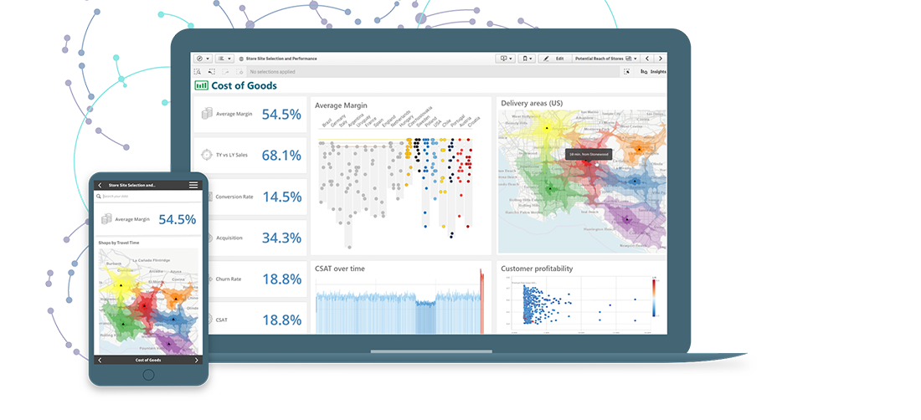
Solution Architecture for Predictive Quality Analytics
Source
Model
Present
Histological Data
Machine Leaning or Deep Leaning Model
Reporting Platform

Slide 7
Proof Of Concept (POC)

Slide 8
Scope of PoC
Data Exploration:
Feature Selection:
Model Selection:
Data Preprocessing:
Model Development:
Performance Metrics:
Integration Points:
Prototype Implementation:
User Interface (UI):
Testing and Validation:
Scalability Assessment:
Documentation:
Training Plan:
Feedback Mechanism:
Timeline and Milestones:
Cost Estimation:
Risk Analysis:
Success Criteria:

Slide 9
High levels steps and Support needed from Client
High Level Steps:
Histological Data
Operational Flow of Data
Store transformed data to database for consumption
UI application to pull the claim information from RDS and display on the screen
Support Needed from Unum:
Current system details
Access to cloud along with required VMs, DB2, S3 bucket, and to run the Python/Java code/.Net, etc.
How frequently the data related to product patch with database

Slide 10
Indicative Plan and Price
Item | Duration | Price in $
POC Development | 8 weeks | 35, 500

Slide 11
Assumptions
The estimation is based on high level understanding of the system and the data required Once we understand the clear requirements, the estimation, plan and pricing may change.

